Slide 1
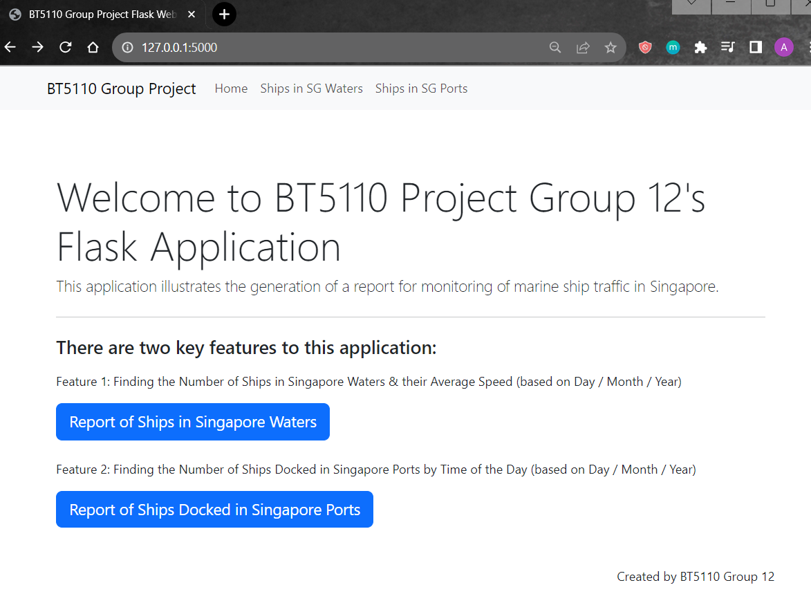

Slide 2
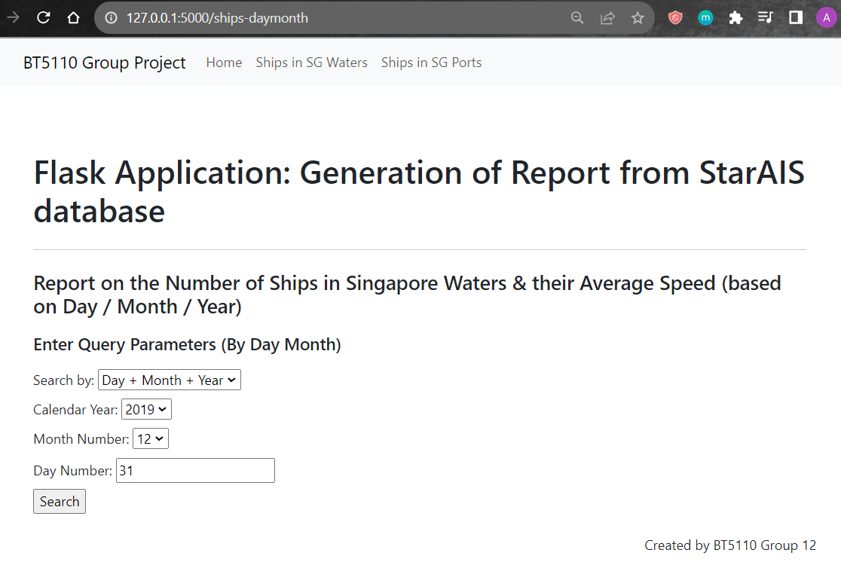




Slide 3
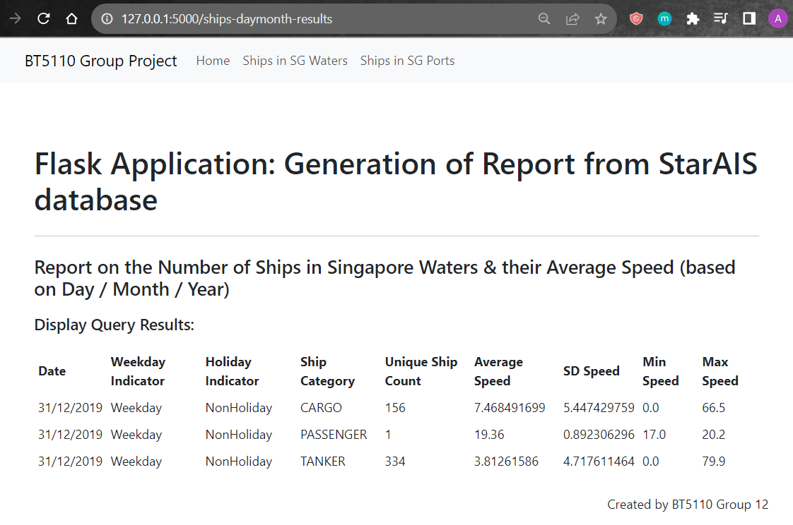

Slide 4
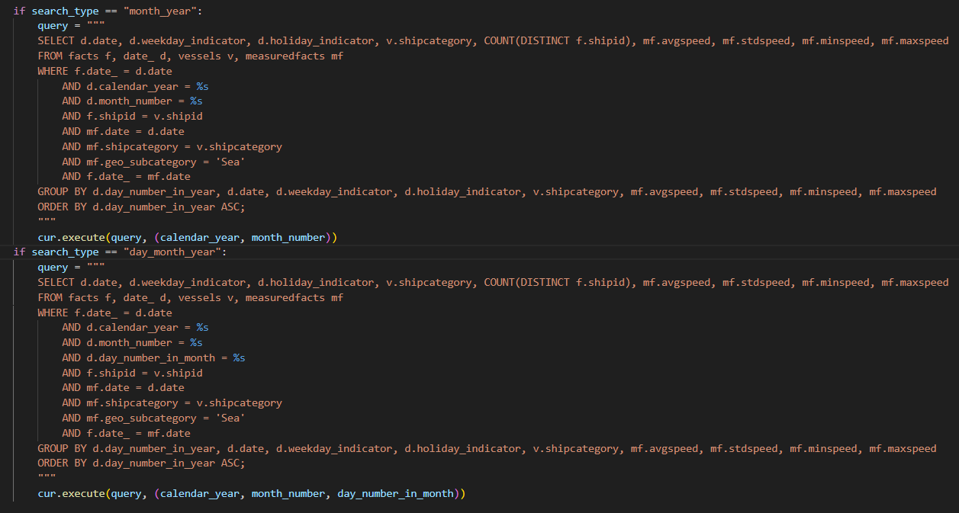
This query is executed if user selects “Month + Year”
This query is executed if user selects “Day + Month + Year”

Slide 5
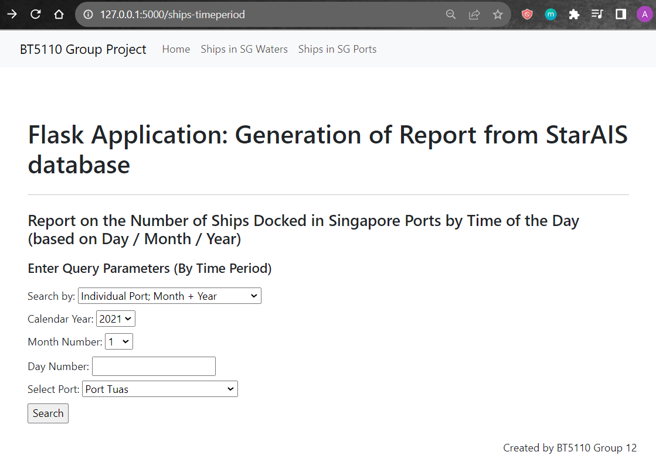

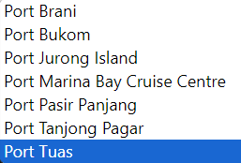

Slide 6
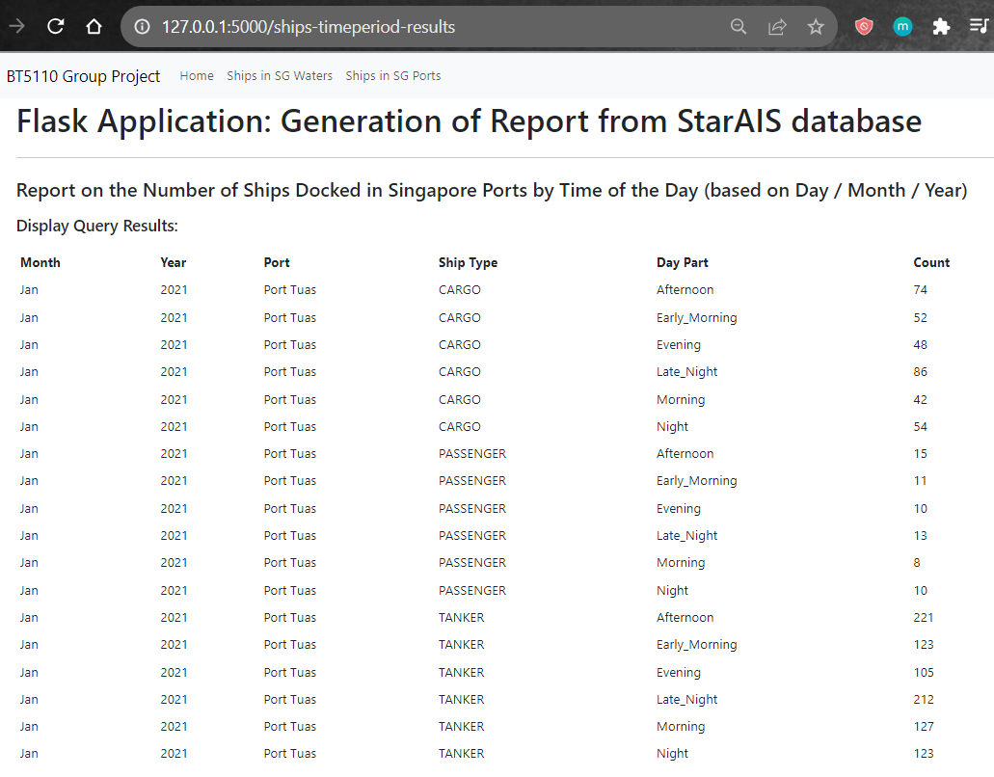

Slide 7
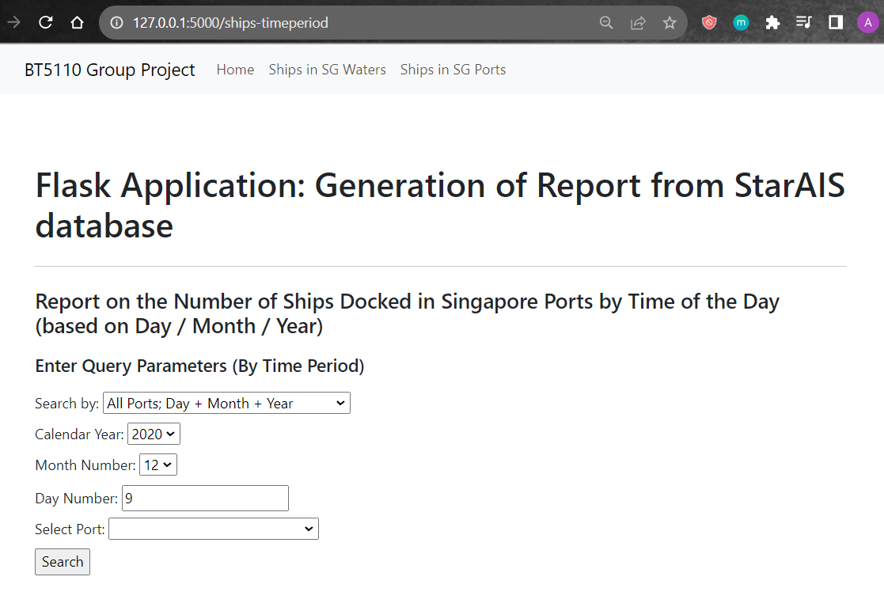

Slide 8
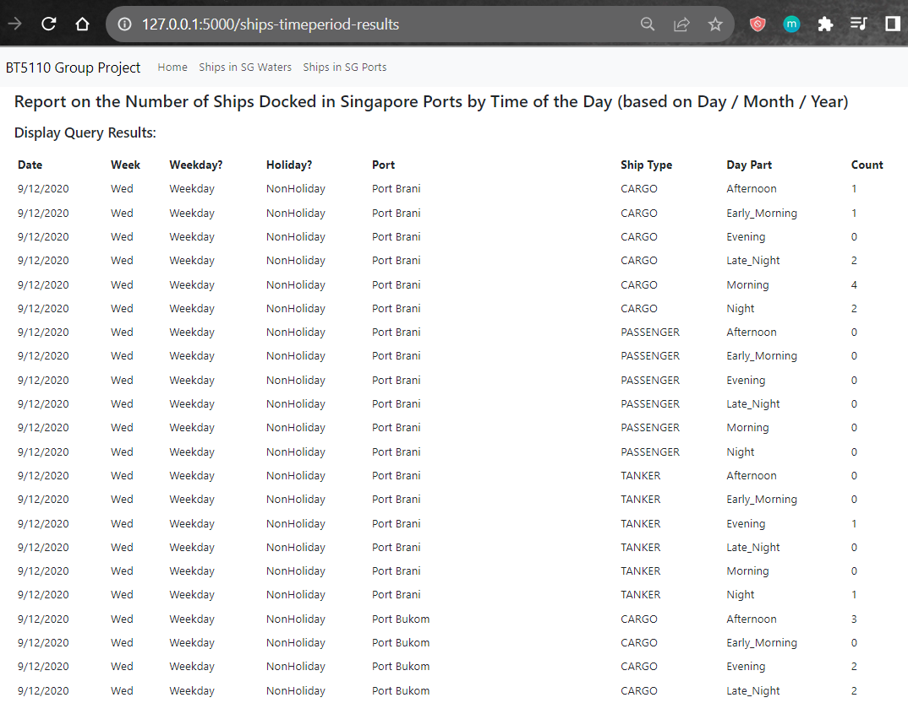

Slide 9
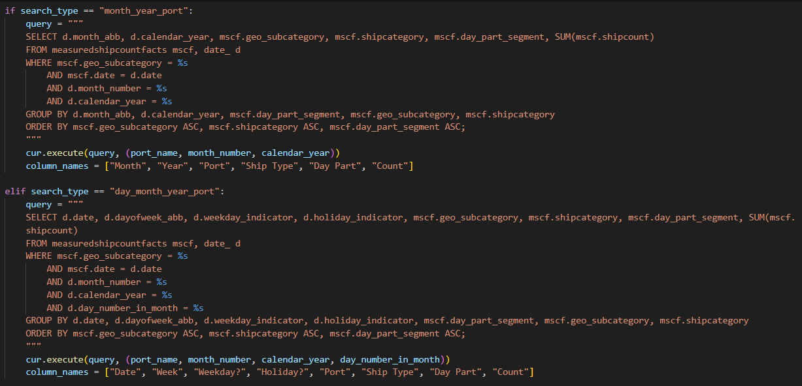
This query is executed if user selects “Individual Port: Month + Year”
This query is executed if user selects “Individual Port: Day + Month + Year”

Slide 10
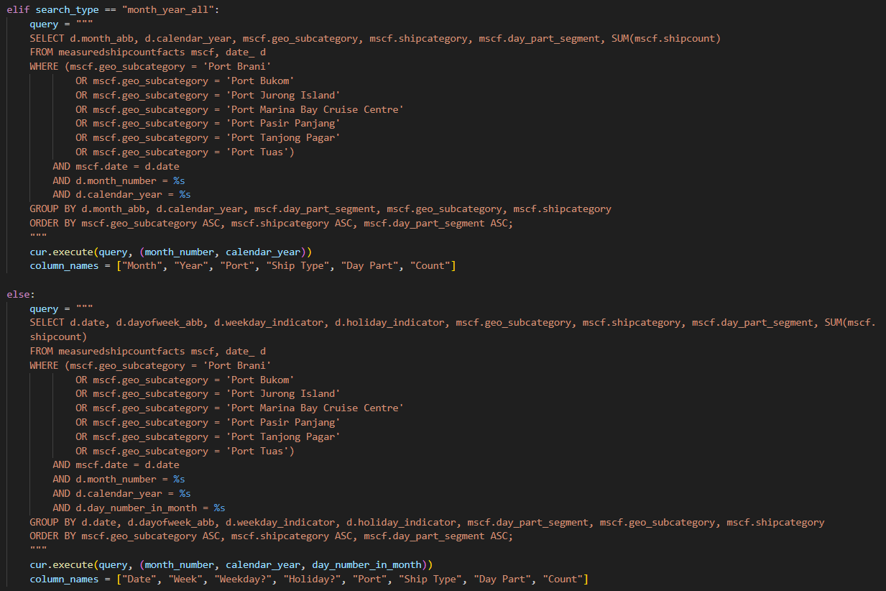
This query is executed if user selects “All Ports: Month + Year”
This query is executed if user selects “All Ports: Day + Month + Year”

